Slide 1
Teacher training
Day 2

Slide 2
Phonological awareness
What is it?
Why is it important?
How is it taught?
How is it assessed?

Slide 3
What is it?
Phonological awareness involves the
understanding that spoken language can
be broken down and these smaller parts can
be manipulated.
Notes:
Several concepts will be detailed in the work shop.
It does not involve print.

Slide 4
Phonological awareness concepts
 |  |  |  | Blending and segmentation of individual phonemes
 |  |  | Onset-rime blending and segmentation
 |  | Syllable blending and segmentation
 | Sentence segmentation
Rhyming songs
Notes:
Activities begins with less complex activities and increase in difficulty.
If children have difficulty mastering a task, instruction should be taken back to a less complex activity.

Slide 5
Is phonological awareness the same as phonemic awareness and phonics ?
Phonological awareness
Phonemic awareness
Phonics
Notes:
Phonological awareness relates only to speech sounds, not to the alphabet letters or sound-spellings. It involves identifying and manipulating larger parts of spoken language. Typical tasks would require children to analyze, make judgements about or manipulate sounds in spoken words – only spoken stimuli are needed.
Phonemic awareness is a subset of phonological awareness, it is when you heard a word and can divide it into the smallest parts.
Phonics requires students to match letters or letter patterns with sounds (decoding) and to use this information to read words. Phonics is the understanding that there is a predictable relationship between phonemes and graphemes, the letters that represent those sounds in written language. The goal of phonics instruction is to help children learn and use the alphabetic principle: the understanding that there are systematic and predictable relationships between written letters and spoken sounds.
Clarification of these three terms is of utmost importance, because the varying use of these terms – phonological awareness, phonemic awareness and phonics – may cause confusion for practitioners.
Very important is the fact that children can be confused if letter sound representations are introduced too soon, before children realize that words are composed of sounds. Letter sound representations should be introduced after phonological skills of segmentation and blending are established

Slide 6
Why is it important?
Important in reading acquisition
Preventing reading problems
Important indicators of early reading skills.
Important in the development of reading skills
Notes:
Children must understand that words are composed of separate speech sounds.
Children with phonological awareness skills are better equipped for learning to read and spell .
Children with phonological awareness skills tend to be better readers, even up to eleven years later.
Positive effects on the development of reading and spelling difficulties:
Phonological awareness → accurate and fluent word identification.
Accurate and fluent word identification → reading comprehension.
Phonological awareness is called the “solid core” for building reading skills; it influences decoding, spelling, word reading and comprehension.
Phonological awareness is a key component in preventing reading problems.
The value of predicting reading ability lies in the fact that reading difficulties can be prevented. The earlier struggling learners are detected, the better the possibility for successful intervention.
Deficits in phonological awareness causes problems with word identification, which causes comprehension problems.
Exposure to literature and level of intelligence are important for overall development, they are less predictive of reading success than phonological awareness.
Emphasize that phonological awareness is a better predictor of reading success than what children know about letters or how often they were read to or SES status.

Slide 7
Instruction of phonological awareness (1)
Many children benefit from explicit instruction in phonological awareness in grade R, because it enhances reading acquisition.
Those who progress slowly in phonological awareness activities should receive special attention, to prevent reading problems.
Notes:
Special attention will be discussed in detail when we get to assessment.

Slide 8
Instruction of phonological awareness (2)
Play-based instruction
Systematic, with progression
Developmental appropriate activities.
Music and movement activities.
Playful and fun.
Interaction among children.
Encourage curiosity.
Not evaluative - informal.
Turtle talk
Well known, short words.
Always include learners’ own names.
Rhymes: Initially teach fewer examples and allow for generalisation.
Syllable shape: CVC
Notes:
Perhaps the most challenging aspect of teaching phonological awareness is that one cannot make a child analyze the sound structure of language. The teacher should repeatedly model analysis, using a think-aloud strategy, showing the child how to solve the problem.
Sequencing in tasks should be driven by task complexity so that simpler tasks are targeted before complex tasks and earlier tasks lead to success on later tasks.
Developmental appropriate activities include songs, rhymes and games.
Music and movement activities, like dances or clapping hands.
Keep a sense of playfulness and fun, avoid drill and rote memorization.
Use group settings that encourage interaction among children.
Encourage children’s curiosity about language and their experimentation with it.
Allow for and be prepared for individual differences.
Make sure the tone of the activity is not evaluative but rather enjoyable, fun and informal.
Turtle talk: Learners or the teacher pretend to be talking like turtles, very
All words used should be part of the learners’ vocabulary.
Start with segmenting short sentences with mono-syllabic words.
Segment and blend two syllable compound words.
Segment and blend two syllable words, start with learners’ own names.
Segment and blend multi syllabic words, start with learners’ own names.
Rhymes: Initially teach fewer examples and allow for generalisation.
Initial sounds are easier than final sounds, start with learners’ own names.
Shorter words are easier to segment than longer words.
Syllable shape is critical. It is easier to segment an initial sound in a CVC word than in a CCV word

Slide 9
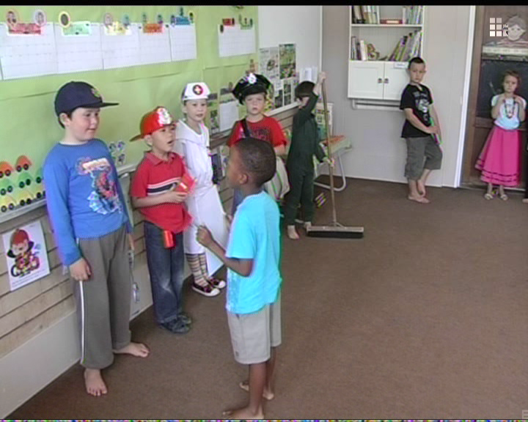

Slide 10
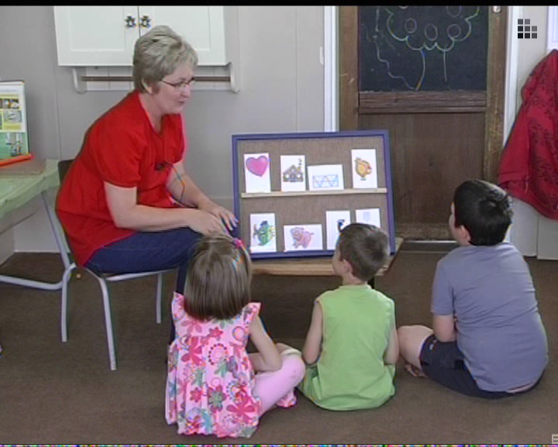

Slide 11
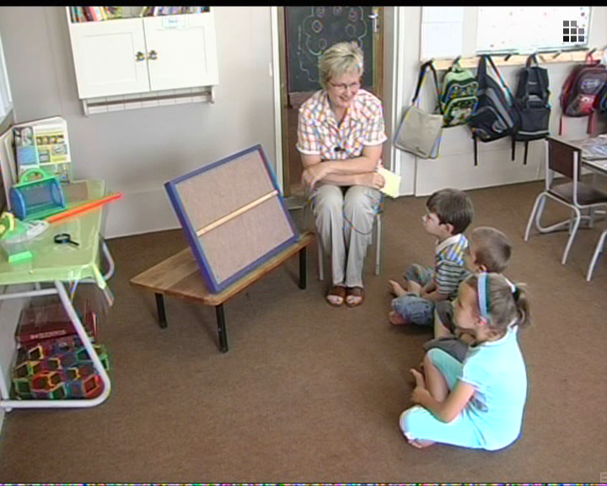

Slide 12
Sequence of activities
Short sentences: Bob likes his bike.
Compound words: Handbag; toothbrush; ladybird.
Two syllable words: Apple; monkey; jersey; present.
Multi syllabic words: Elephant; umbrella.
Rhyme: Fewer examples and allow for generalisation.
Initial sounds: Pen; pot; pin; pan.
Final sounds: Cat; hat; goat; ant.
Notes:
Segmentation of short sentences: Bob likes his bike; Please drink your milk.
Segment and blend compound words: Handbag; toothbrush; motorbike; ladybird; teapot.
Segment and blend two syllable words, start with learners’ own names: Apple; monkey; jersey; present; Mary; Andrew; Susan.
Segment and blend multi syllabic words, start with learners’ own names: Elephant; umbrella; butterfly; Aiden-Lee; Mohammed.
Rhymes: Initially teach fewer examples and allow for generalisation: house + mouse; hat + cat; door + floor; tap + cap.
Initial sounds are easier than final sounds, start with learners’ own names.
Shorter words are easier to segment than longer words; it is easier to segment an initial sound in a CVC word than in a CCV word:
Car, hen, pen, man, pot, ant, cat, hat, sun, six.
Refer to/ handout booklet in relevant languages

Slide 13
Knowledge and skills
First term
Second term
Third term
Fourth term
Notes:
First term:
Can divide spoken sentences into individual words.
Identify rhyming words and distinguish non-rhyming words.
Can identify words in compound words, e.g. Say cupcake, without cup.
Say own name slowly to identify syllables; clap syllables of own name.
Identify syllables in spoken words, move manipulatives to represent syllables in words.
Identify beginning sounds. My name begins with /t/.
Second term:
Can anticipate rhyming words and complete the sentence.
Identify and isolate the initial and final sound of a spoken word.
Name the letter his/her name begins and ends with.
Third term:
Recognise that words are made up of individual sounds:
Blend sounds to make spoken words such as moving manipulatives to blend phonemes in a spoken word.
Listen to a sequence of separately spoken phonemes and combine them to make a word.
Recognize the same sound in different words, e.g. /d/ in dad; hand; dog; Donald.
Recognise the word that remains when a phoneme is removed, e.g. say mat without /m/
Make new words by adding a phoneme to an existing word, e.g. s + nail=snail
Fourth term:
Manipulate phonemes with confidence.
Segment one-syllable spoken words into individual phonemes, clearly producing beginning, medial and final sounds.
Can substitute one phoneme for another, e.g. pen →pan.
Can cut own names into letters and ‘build’ it correctly.
Name the sounds in own name.

Slide 14
Monitoring progress of
Phonological Awareness
Observe nature of errors
In the beginning – more support
With progression – less support
Learning is best characterized by moving a child from:
  successful performance with maximal support → successful performance with little or no support.
Notes:
Monitoring is a continual activity
Errors: The nature of a child’s errors, as well as successes, indicate the type of scaffolding a child needs.
In the beginning: The adult literally carries the child through the task.
As the child gains skill and independence: the adult provides less support.
Learning is best characterized by moving a child from:
successful performance with maximal support → successful performance with little or no support.

Slide 15
Keeping track of progress:
Example of Assessment tool
Literacy THIRD TERM FOURTH ASSESSMENT | 1 | 2 | 3 | 4 | 5 | 6 | 7 | 8 | 9
PHONOLOGICAL AWARENESS
Recognise the word that remains when a phoneme is removed, e.g. say mat without /m/
Make new words by adding a phoneme to an existing word, e.g. s + nail=snail
Can substitute rhyming words in common songs and rhymes when asked to do so.
Notes:
The same key will be used as prescribed in the Policy Documents of the Department of Education:;
National Assessment and Qualifications for Schools.
Not achieved
Partial achievement
Satisfactory achievement
Outstanding /excellent achievementMonitoring progress will help to modify curriculum and instruction; and identify concepts with which a student may be having difficulty.
Emphasize that teachers can assess progress on a frequent basis using an Assessment tool as the set example.

Slide 16
The relationship between: Teaching and Assessment
Effective teaching does not separate teaching from assessment.
Effective teaching is informed by assessment:
  the pace
  the progression in difficulty
Assessment is a planned, continuous process:
  identifying
  interpreting information
Notes:
Effective teaching does not separate teaching form assessment.
Effective teaching is informed by assessment, about the pace as well as progression in difficulty.
Assessment is a planned, continuous process of identifying, gathering and interpreting information about the performance of learners. It involves four steps:
Generating and collecting evidence of achievement.
Evaluating this evidence against the outcomes.
Recording the findings of this evaluation.
Using this information to assist the learner’s development and improve the process of learning and teaching.

Slide 17
Teaching activities
16 lesson plans included.
Repeat activities during the day:
  “Turtle talk” names when taking the register.
  Sing “Beginning sound song” while visiting the bath room.
  Ask beginning and ending sounds while putting up labels for theme discussion.

Slide 18
What have we learned today?
The importance of phonological awareness
Distinguish: phonological awareness + phonics
Teaching activities
Assessment
Notes:
Allow for questions and comments

