Slide 1

The day the current disappeared
Johan.Rens@nwu.ac.za
3 May 2019

Slide 2
Contents
Finding current: What did Maxwell miss?
Why the Polish knight wanted to climb another mountain…
That is why the current went missing!
Until sanity was restored by the IEEE 1459-2010
Application in impedance-constrained networks

Slide 3
A brief history of nearly every electron
Electricity as a matter of physics since BC
Found application during 1800’s: “electrical engineering” – using this resource to do “something”, mostly to better life for mankind
Moving electrically charged electrons and protons = current is flowing
Mostly done in an alternating manner (ac electricity)
How well it is done governed by the constant law of misery in electrical circuits: Ohm
And that misery made the current disappear…..

Slide 4
On average, the voltage remains shockingly zero
v(t)_{loss}
i(t)
v(t)_{source}
v(t) _{load}
Resistive component of load
Reactive component: L, C or both

Slide 5
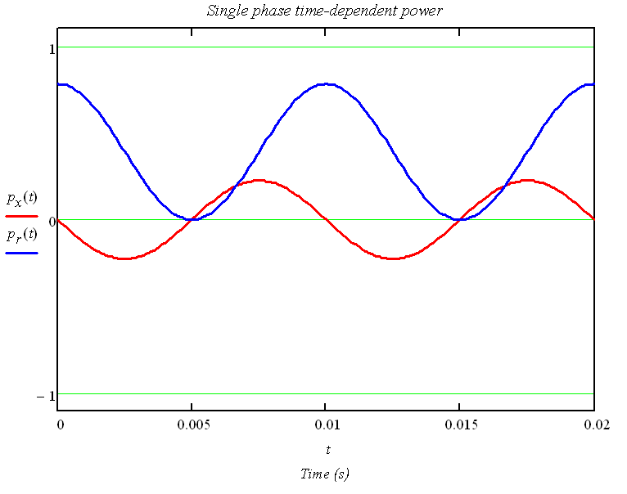
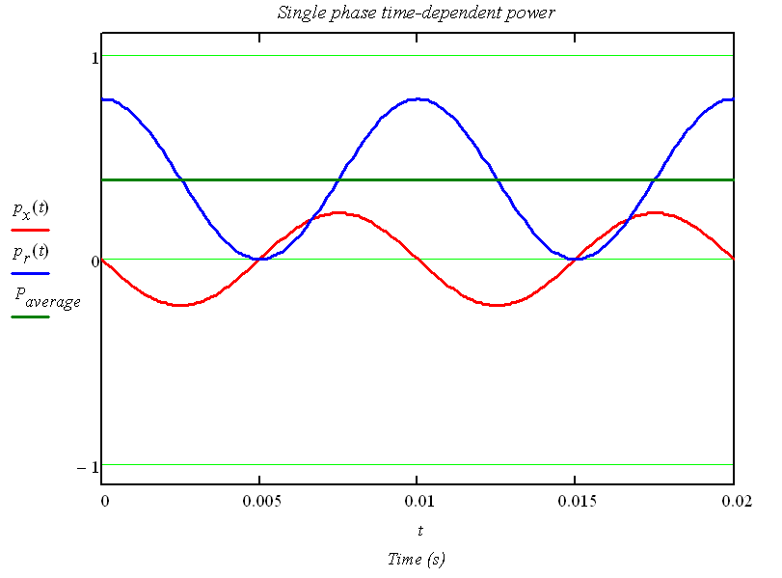
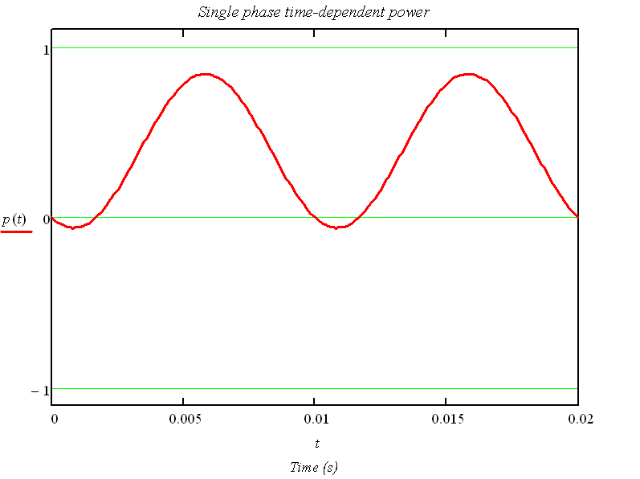
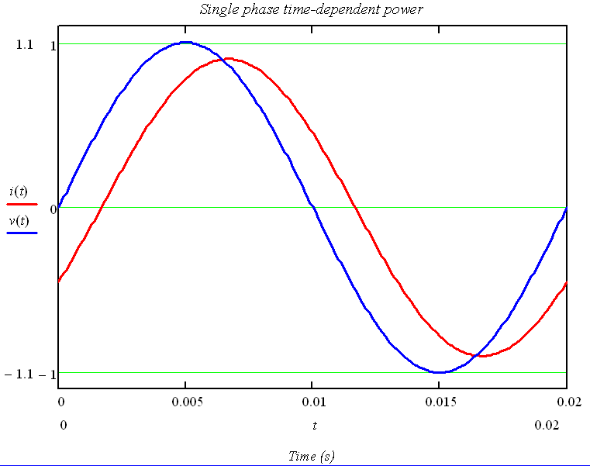
That is why that single-phase generator remained so small….
v(t)_{loss}
i(t)
v(t)_{source}
v(t) _{load}
Real work done:

Slide 6
That is why we have 3-phase electricity
i(t)_{a}
v(t)_{a}
i(t)_{b}
p(t)_{a}
v(t)_{b}
p(t)_{b}
p(t)_{3-phase}
v(t)_{c}
i(t)_{c}
p(t)_{c}

Slide 7
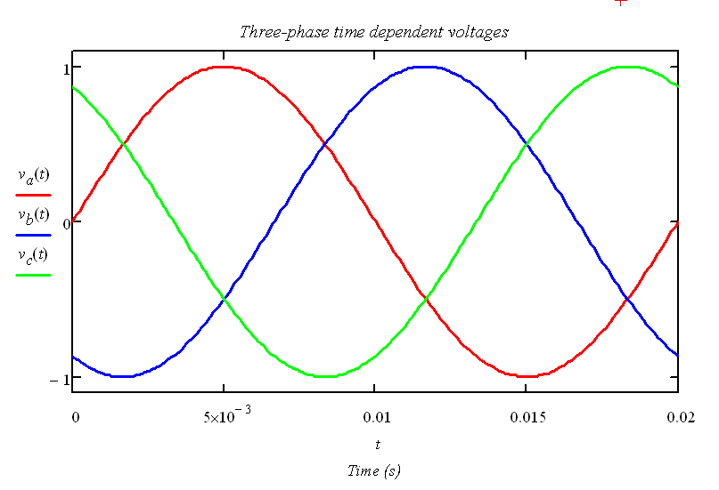
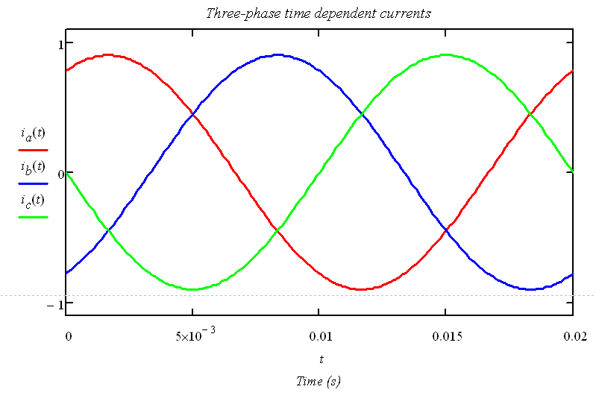
The War of Currents winner : George Westinghouse; 1886

Slide 8
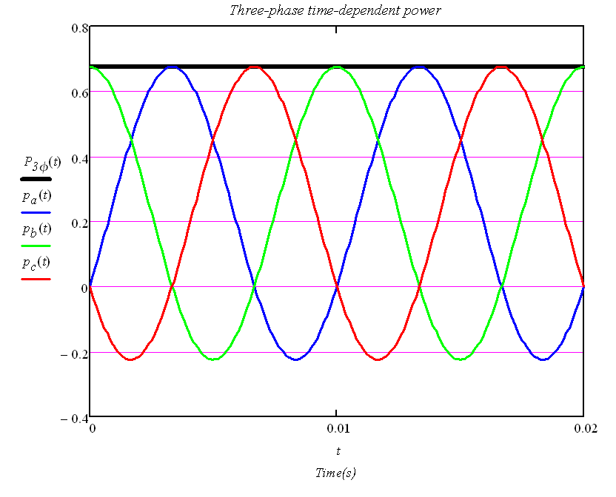
The War of Currents winner : George Westinghouse; 1886

Slide 9
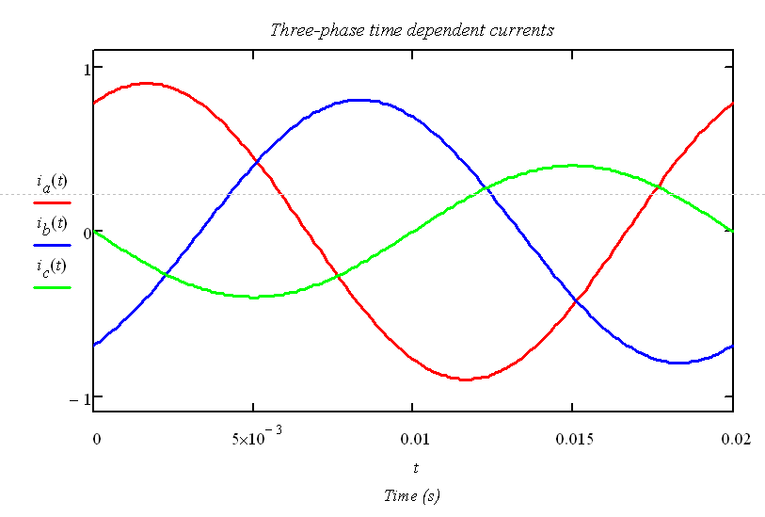
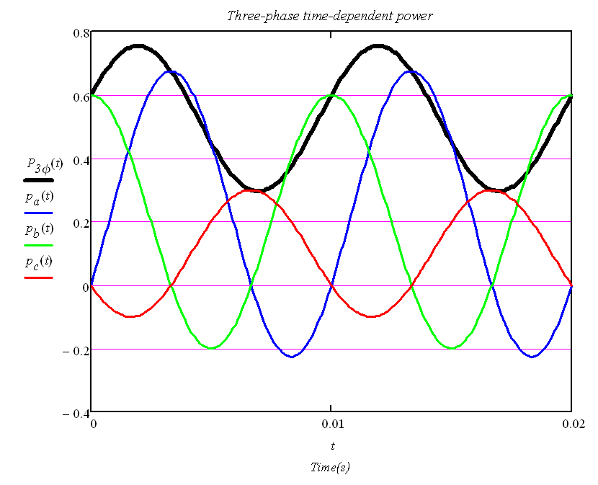
And if those voltages are no longer symmetrical and those currents unbalanced?
The time-independent feature of three-phase energy transfer is lost……

Slide 10
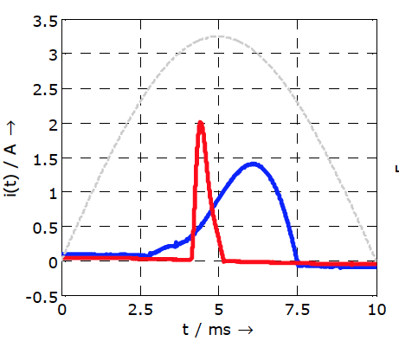
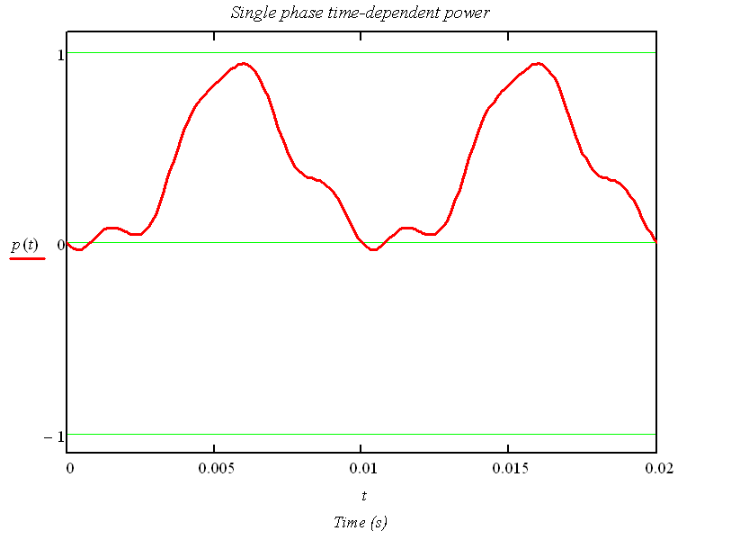
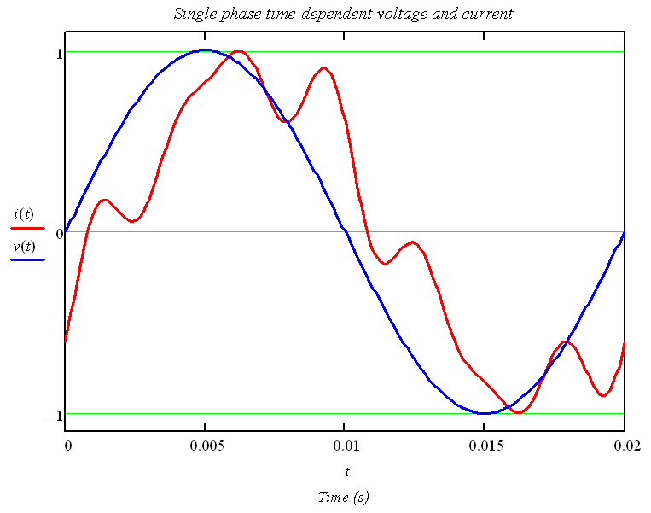
It get worse when the load is non-linear (and supply voltage non-sinusoidal)….
What does non-linear loading mean?
More or less the modern way of consuming current
Such as in a LED lamp, a laptop charger and and and
Nowadays, MW’s and kV’s
The energy transfer is impacted
We are used to:
LED lamp
Laptop charger
Not anymore….

Slide 11
Now this is where the current got lost!
Distortion power?
What is that?
Something missing in power theory?
Budeanu defined the concept of distortion power – as “distortion” is the cause
Many contributions to power theory followed
Modern power phenomena required new definition
Engineers have to design, specify and operate power system in which energy phenomena has physical intrepetation
Why is the term “distortion power” then still in use?
Discussion became intense………
Notes:
Back to single-phase power systems: Assume our RLC load is replaced by a non-linear load, that is a load with the ability to dictate the withdrawal of current due to (for example) a solid-state element such as a diode or thyristors that are inserted between the source and the RLC load. The result is the blue line indicating the non-linearity of the resulting current waveform. The layman term for this “effect” is to say “there are harmonics in the load current”. More about that, later on.
Again, multiplication of voltage and current reveals the time-dependent character of power transfer- but the red line clearly has a different “shape” then when no harmonics were present.
Our classical power theory should be able to quantify the power in our new circuit as was possible earlier. In terms of complex power (indicated in bold), we know the orthogonal relation with active power (P) and reactive power (Q). The squared relation between these components are known. But, this relation is lost!
Apparent power can no longer be explained only in terms of active and reactive power as “something” is missing. Even today, engineers “talk” about distortion power (symbol D). Historically, it was a simple mathematical isolation of the missing component in power and then terming it distortion power.
Appreciate that engineers have to deal with a physical world- to operate power systems and to design require a clear explanation of the physical phenomena. This hint already to the constraints when contributing to a new power theory.
Distortion power cannot be assigned a clear physical explanation and this statement will be investigated by means of case study later in this module.

Slide 12


Sixth International Workshop on Power Definitions and Measurements under Non-Sinusoidal Conditions Milano, October 13-15, 2003

Slide 13
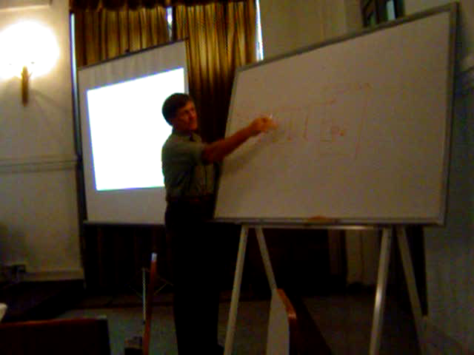
And then the Polish knight
arrived…

Slide 14
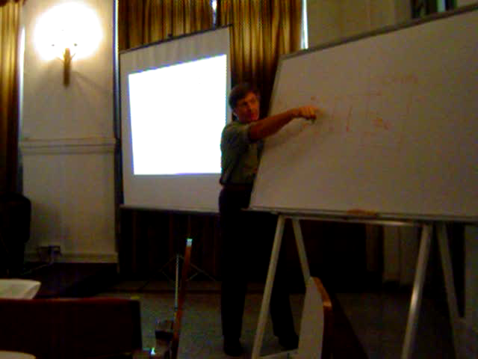

Slide 15
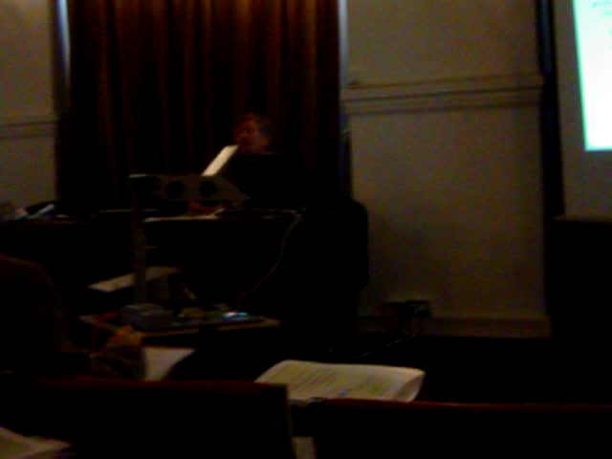

Slide 16
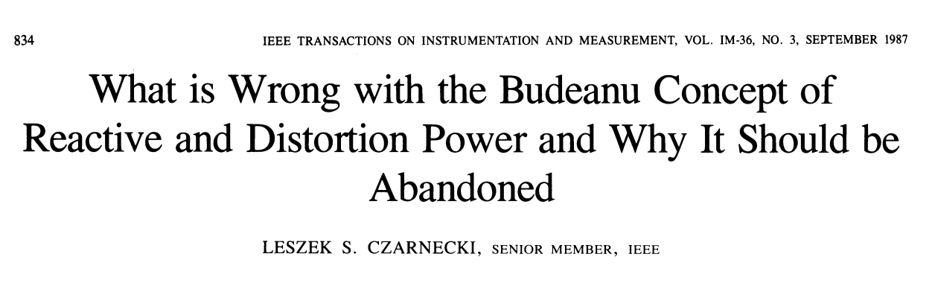

Shouldn’t we rather abandon the knighthood?

Slide 17
But what is the problem?
Steinmetz (1892): Ratio of active to apparent power decrease when waveform becomes more distorted such as electric arc (lighting application).
Impact of distortion and unbalance new phenomena
Power factor reduction a concern -
Unbalance in loading, asymmetry in supply voltages, AND distortion in voltage and/or current contributes to the degradation of power factor (the effiency in the transfer of real energy)
Classical power theory can only deal with perfectly sinusoidal voltages, perfectly symmetrical between phases and perfectly linear loads that withdraw perfectly balanced currents
Budeanu (1927) described S² > P²+Q² when waveforms are non-sinusoidal
IEEE-1459-2010 attempted to further practical formulations universally acceptable for engineers to deal with modern power systems

Slide 18
Historical overview
Notes:
A brief overview is given of some of the significant contributors to power theory. Those marked in bold have been quite active in terms of creditable publications.
The IEEE has recognised the need to a practical approach to power theory for the engineer as contributions to power theory are still forthcoming and has started to formulate an opinion in the 1990’s. There contribution to power definitions will thus be the main focus of this part of module 8.

Slide 19
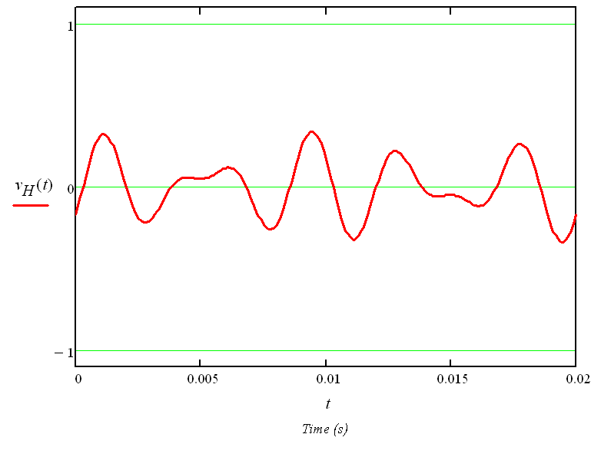
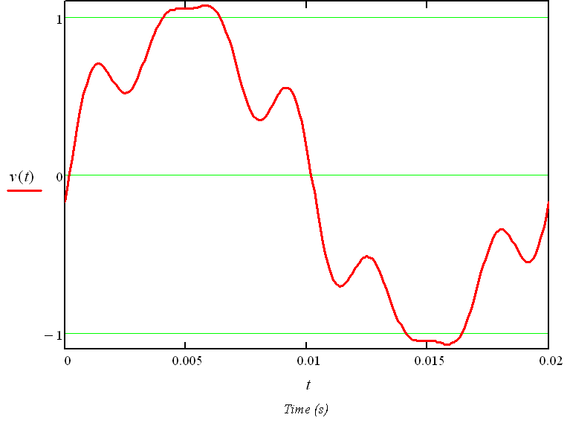
Effective values: nonsinusoidal waveform conditions (1)
The IEEE 1459-2000 document further practical guidelines on power definitions
The time-domain or the frequency domain can be used for power definitions
Focus will be on frequency domain power definitions in this presentation
A non-sinusoidal, single-phase, time-dependent voltage v(t)_{1ϕ}with fixed and repetitive period T is applied to a load - represented as a finite series of harmonic components: h=1, 5, 7
Single phase distortion component of v(t)_{1ϕ} can be isolated as v_{H}(t)_{1ϕ}:
Notes:
Power definitions will now be formulated as suggested by the IEEE in the IEEE 1459-2000 document. The first phenomena is that of harmonics. It is necessary to agree on how harmonics will be included in the formulation of rms values for voltage and current. This concept is first introduced as an “effective” voltage and current value for a single-phase (or per phase) scenario. The contribution of the non-fundamental frequency components to the non-sinusoidal waveform is grouped into a single equation to indicate the impact of harmonics against the fundamental frequency component. The “harmonics-only” component is lastly shown as v_{H}(t).

Slide 20
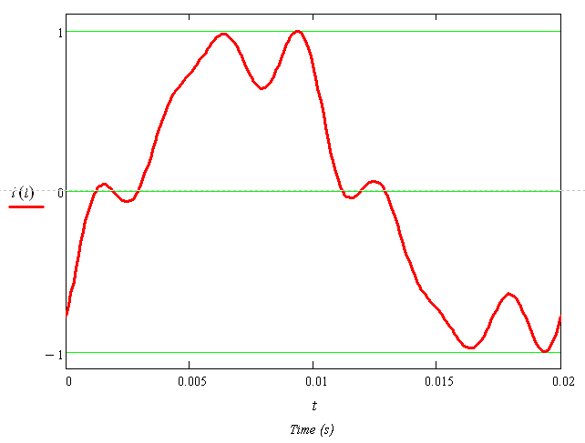
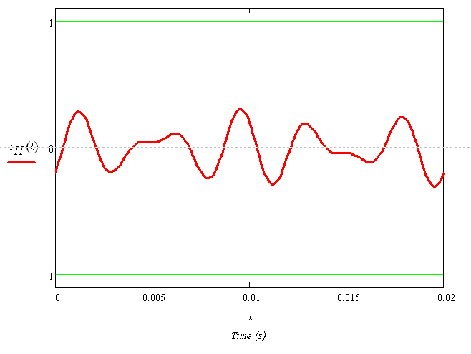
Effective values: nonsinusoidal waveform conditions (2)
i(t)_{1ϕ} when v(t)_{1ϕ} is applied to frequency dependent impedance load:
Distortion components i_{H}(t)_{1ϕ}:
Notes:
A similar result is obtained in terms of current: the current harmonics is grouped into a single equation [i_{H}(t)] with the capital H indicating that all the harmonics grouped together.

Slide 21
Active Power: nonsinusoidal waveform conditions
The effective or RMS values:
The single phase power:
Classical power theory formulates Time-dependent Active Power (per harmonic order h):
The Time-dependent Total Active Power of a circuit under distorted waveform conditions:
Total (or Joint) Average Active Power requires integration over a period T:
Notes:
The IEEE 1459 introduced the concept of “effective” values against RMS values. It is the same mathematical formulation for a single-phase power system as shown by these formulas.
Assume that the concept of RMS values applies in this section as this concept is universally known and used.
Recall that the classical power theory has been formulated for a single-frequency power system and is universally accepted as been able to assign a physical explanation to the concepts of active and reactive power. The application thereof can thus be done on a per-harmonic basis and the time-dependent total power is then found by summating over all harmonics.
The average active power requires integration over the period to which it refers and results in a summation of the active power per harmonic order. This summation of active power is known to have a physical explanation as it is explained by the heat-gain in a resistive element because all harmonic active powers will contribute and thus an acceptable formulation.

Slide 22
Reactive Power: nonsinusoidal waveform conditions
Classical power theory formulates Time-dependent Reactive Power (per harmonic order h):
The Time-dependent Total Reactive Power of a circuit under distorted waveform conditions:
Does it make sense?
It does not make sense!
Total (or Joint) Average Reactive Power requires integration over a period T:
Notes:
A similar approach to reactive power can be used, but with the result that the summmation does not make sense. This statement will be supported by a case study in this module that will prove that the Budeanu reactive power has no clear physical intrepetation. A similar argumentation was used by LS Czarnecki in his famous paper “Why the Budeanu Power Theory is Wrong and should be Abondoned”.

Slide 23
Summary of Budeanu’s definitions
Budeanu’s Distortion Power
Total Active Power
Total Reactive Power (Budeanu’s Reactive Power)
Notes:
A summary is given of Budeanu’s power definitions. Engineers are still using these concepts although it is known now for many years that neither the reactive power nor the distortion power formulation has any practical meaning. The value of noting these formulations in this module is to clearly indicate what it entails AND to indicate that the mathematical manipulation of the time-dependent power as shown, can easily result in the conclusion that distortion power (for example) has it’s roots in the cross-products of the harmonic components.

Slide 24
What is wrong with Q_{B} – the Budeanu Reactive Power?
Physical nature of reactive power follows from the application of field theory (Maxwell’s equations)
Reactive Power not to contribute to real energy transfer
Physical nature of reactive power - energy accumulation in electric and magnetic fields of reactive components in the load and source
Results in oscillatory exchange of energy between these reactive components
Similar explanation assigned to harmonic reactive power Q_{h} at each harmonic order h
Is Q_{B} (Joint/Total Reactive Power) a useful concept?
Let’s investigate……
Notes:
It is field theory that explains to us the physical phenomena of energy in electrical circuits. Reactive power is clearly understood in terms of the energy exchange between reactive elements in load and source. Let’s investigate….

Slide 25
Application of Q_{B}in power factor correction (1)
i(t)
v(t)_{1ϕ}
10 ohm
100 mH
PF = 0.3 based on Q_{B}
Notes:
Assume an instrument is measuring the total reactive power (Budeanu’s formulation). A simple circuit is shown with harmonics as indicated in the voltage source. Network analysis show that a PF of 0.3 exist. PF correction can now be done based on this value of 0.3.

Slide 26
Application of Q_{B} in power factor correction (2)
i(t)
v(t)_{1ϕ}
10 ohm
64 μF
100 mH
Calculate the capacitance in parallel to compensate Q_{B}
Notes:
Take note that the value of C has to be found by accounting for the voltage harmonic components.

Slide 27
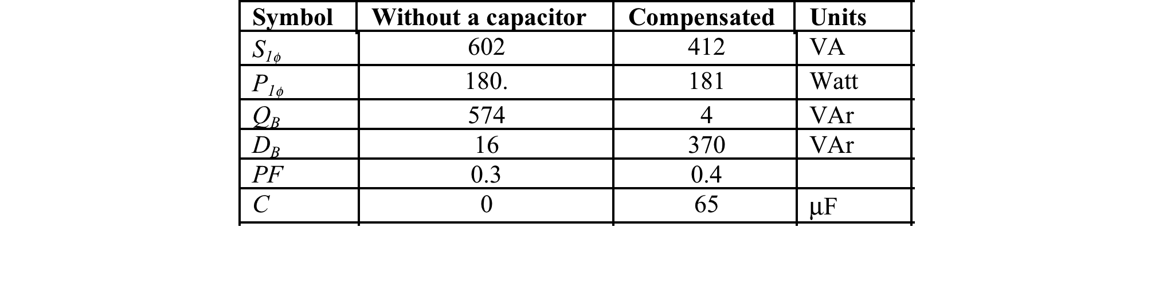
Application of Q_{B} in power factor correction (3)
Q_{B} completely compensated by capacitor, but- power factor of compensated circuit did not change significantly.
Apparent power is less in compensated circuit but unnecessary loading remains (difference between apparent power and real power).
Remark
Budeanu’s reactive power (Q_{B}) not useful for power factor compensation.
Power factor correction results in “distortion power” (D_{B}) to increase significantly due to increased interaction between uneven harmonic voltage and current components.
Notes:
The apparent power is certainly reduced by the parallel addition of C. The active power did not change as expected. Reactive power (Budeanu) seems to be reasonably reduced. But, the distortion power has increased! Indeed, the apparent power is still enough to result in a power factor of 0.4! The PF cannot be mitigated further by means of a capacitor. It is thus clear that application of Budeanu’s formulation of reactive power in this compensation exercise was not helpful.

Slide 28
Does distortion power D_{B} make sense?
i(t)
v(t)_{1ϕ}
1 ohm
D_{B} has zero value: waveforms perfectly sinusoidal?
Both voltage and current are distorted!
D_{B} does not relate to degree of waveform distortion.
Notes:
Distortion power is the third apparent power component and a similar approach can be followed. Assume a non-sinusoidal voltage is applied to a resistive load. The load current will have a similar shape. The numerical results indicate that the PF is 1.0 as neither reactive nor distortion power exists in this circuit. This contradicts the expectation as it is clear that both voltage and current is distorted and the concept of “distortion” power should have assisted in quantifying the degree of, and effect of, the distortion in the waveforms. It is thus concluded that distortion power is not related to waveform distortion.

Slide 29
Summary: Power theory in a modern power system
It must, as far as possible consist of a generalisation of the classic single-frequency power theory that has by now been universally accepted.
It must be as amenable to conventional measurement techniques as possible and require the minimum of sophistication in instrumentation.
It’s different defined components must be relatable to physically observable or ascribable phenomena and not to hypothetical or abstract mathematical definition.
It must present a suitable basis for quantifiable measurement, control, tariff systems and design.
It must cater for every conceivable practical situation and never violate circuit laws, regardless of which domain it is transformed into.
It must be useful to the engineer who has to apply these definitions in design, specification and operation of the power system.
Notes:
The requirements of a power theory is considered.

Slide 30
Modern Power Theory
2. The IEEE 1459 made easy
Notes:
The IEEE 1459 is introduced in this section as a practical approach to power definitions for the engineer who has to operate and design within a practical power system:
Harmonics in voltage and current
Unbalance in loading
Asymmetry between phase voltages

Slide 31
What is a modern Power System? (1)
Condition 1: Non-sinusoidal supply voltages at a PCC…..
Notes:
Line-neutral voltages and line currents obtained in real-life power system is shown. Note the non-sinusoidality in both.

Slide 32
What is a modern Power System? (2)
Condition 2: Nonlinear load current …..

Slide 33
What is a modern Power System? (3)
Condition 3: Unbalance in loading…
Notes:
Real-life measurements of an arc furnace indicate the unbalanced loading that can occur with the asymmetrical voltage at the PCC shown next possibly the result thereof due to asymmetrical voltage drops over the supply impedances towards this load.

Slide 34
What is a modern Power System? (3)
Condition 4: Asymmetrical supply voltages….

Slide 35
The IEEE 1459-2000: Voltage and Current (1)
A Three-phase power system under non-sinusoidal waveform conditions,
unbalanced loading and asymmetrical supply voltages is considered.
Sinusoidal, balanced and single-phase power system operation is easily introduced as a simplification
Define nonsinusoidal line-neutral voltages and line currents:
Notes:
Let’s apply the IEEE 1459 to a practical power system- but first- the formulations have to be introduced! It is done for a three-phase power system with all the unwanted effects: asymmetrical voltages, unbalanced currents, harmonics in both the current and voltage. A mathematical representation of such three-phase waveforms are given.

Slide 36
The IEEE 1459-2000: Voltage and Current (2)
DC components in voltage, (V_{a0}, V_{b0} and V_{c0}) should always be zero.
DC values in line currents (I_{a0}, I_{b0} and I_{c0}) could be nonzero depending on nature of load.
The RMS line-neutral voltage V_{a} and RMS line current I_{a} (similarly for phase b and c) are related to harmonic components by:
Fundamental frequency and the nonfundamental frequency (harmonic frequencies grouped)
Notes:
The concepts of RMS values applies per phase and the previously introduced grouping of fundamental frequency and non-fundamental frequency components are shown.

Slide 37
The IEEE 1459-2000: Voltage and Current (4)
What is the “effect” of three-phase voltages and three-phase currents in terms of the three-phase power system?
“Effective” voltage and “effective” current to represent the state of the three-phase power system:
“Effective” voltage and “effective” current in a 3-wire three-phase power system:
Notes:
The IEEE choose to use the concept of and “effective” three-phase value rather than using a RMS value per phase. A single value can thus be used to describe the global “effect” of the three-phase power system in terms of voltage and current. It is however necessary to understand that the “effective” value of a 3-wire three-phase system can be different from a 4-wire three-phase power system. The formulation for a 3-wire system is shown, BUT the voltage values in use is line-neutral values in this slide.

Slide 38
Calculating the effective voltage and current (1)
If an artificial neutral point in a 3-wire three-phase system is not used to find the line-neutral voltage values, the effective three-phase voltage can be calculated from the RMS phase-phase voltage values as:
The fundamental frequency componens of the effective voltage and current in a 3-wire three-phase power system:
Notes:
The “normal” approach is to use line-line voltages in a 3-wire three-phase power system which requires the formulation as shown. Similar, the fundamental and non-fundamental frequency components can be grouped.

Slide 39
Calculating the effective voltage and current (2)
Non-fundamental frequency components of the effective voltage and current in a 3-wire three-phase power system:
Non-fundamental frequency components relates to the harmonic components (line-neutral voltages assumed):

Slide 40
Calculating the effective voltage and current (3)
Unbalanced condition in a 4-wire three-phase power system requries reformulation of the effective voltage and current :
The fundamental frequency components of the effective voltage and current in a 4-wire three-phase power system:
Notes:
A 4-wire three-phase power system has to include the affect of asymmetry in voltages AND the neutral current which lead to new formulations for voltage and current. Again, the fundamental and non-fundamental frequency components are distinguished.

Slide 41

Calculating the effective voltage and current (4)
The non-fundamental frequency components of the effective voltage and current in a 4-wire three-phase power system:
Implementation straightforward with modern digital instrumentation
Notes:
It is possible that some confusion has been introduced….
But, modern digital instrumentation do not really care about maths!

Slide 42
And power? Not all S is the same S…..
Arithmetic apparent power S_{A}:
The Budeanu power definition for single-phase power systems are applied per phase
Vector apparent power S_{v}:
Active, Budeanu’s reactive and distortion power is summated over all three phases:
Notes:
Now, some more confusion requires attention: Not all three-phase apparent power is the same! It depends on how aggregation of harmonics and phase values are done. Carefully note the different approaches.

Slide 43
And the effective apparent power is…..
The three-phase or system effective apparent power S_{e} can be written in terms of the contribution of all harmonic components:
The components in the system effective apparent power S_{e} can be grouped in the fundamental and nonfundamental frequency voltage and current components:
The non-fundamental frequency apparent power S_{eN} consist of 3 “distortion” components:
Notes:
The IEEE 1459 formulated the effective apparent power and grouped it into fundamental and non-fundamental frequency components. Subscript N is again used to indicate the non-fundamental frequency component.
The non-fundamental frequency component is broken up further into three components, all termed distortion powers but with subscripts indicating distortion from current, voltage and the interaction thereof. More explanation on the following slides.

Slide 44
And the “distortion” powers are…..
V_{e,1}I_{eH}: The current distortion power, D_{eI}
V_{eH}I_{e,1}: The voltage distortion power, D_{eV}
V_{eH}I_{eH}: The harmonic distortion power, D_{eH}
An effective harmonic apparent power S_{eH} is defined:
Notes:
These “distortion” powers are assigned names by the IEEE 1459 as shown to indicate the impact of distortion in either voltage or current on the respective fundamental frequency components and thirdly, the interaction between harmonics in both.

Slide 45
The Total Three-Phase Active Power
The Joint (Total) Harmonic Active Power of three-phase power system:
The Joint Active Power of three-phase power system:
Notes:
Information on the phasors per harmonic order in voltage and current allow for calculating the Total Harmonic Active Power, that is excluding harmonic order 1. Inclusion thereof results in the Joint Active Power which now includes harmonic 1.

Slide 46
And how much is that “distortion”?
Quantification on the level of distortion is done with three-phase effective values:
Voltage total harmonic distortion factor: VTHD_{e}
Current total harmonic distortion factor: ITHD_{e}
The IEEE 1459-2000 write these symbols as THD_{eV} and THD_{eI}
Notes:
It is common to find that PQ standards quantify the level of distortion in voltage (and sometimes current) per phase, but as the the IEEE 1459 attempts to ascribe a single value for the “effective” distortion in the three-phase power system, the Voltage Total Harmonic Distortion Factor based on the three-phase effective values for fundamental and non-fundamentel frequency values can be used, as shown.

Slide 47

These distortion factors are useful!
A shortcut to S_{eN}:
And to D_{eI}; D_{eV}; D_{eH} (The “distortion” powers):
To do what with?
Notes:
It seems like formula’s and more formula’s! Those distortion factors are useful. For eaxmple, appreciate how easy it is by application of distortion factors only, to find the non-fundamental frequency apparent power, S_{eN} making use of the fundamental frequency apparent power. The distortion powers in current, voltage and in the interaction of harmonics, can similarily be found from the fundamental frequency apparent power.

Slide 48
To quantify the pollution….
Harmonic pollution (S_{eN}/S_{e1}):
Unbalance pollution:
The positive sequence voltage (V₁⁺) and current (I₁⁺) in the three-phase fundamental frequency components have to be found…..
Then calculate:
The “unbalance pollution”:
“Unbalance pollution” includes both the effect on loading unbalance and voltage asymmetry
Notes:
And more use for those “effective” distortion factors- the level of pollution due to harmonics can be found in a straightforward way- square root will result in the harmonic pollution in per unit value- it includes the current harmonics and representing the affect of harmonic powers, not only quantifying the distortion in voltage - as commonly used – but doing more.
The contribution to the growth in apparent power due to both voltage asymmetry and unbalance in loading can be isolated by the approach shown. First find the apparent power due to unbalance and then calculate the ratio thereof to the total apparent power in terms of effective values (S_{e1}) – expressed as a percentage and it tells us what part of apparent power cannot be compensated by means of capacitors- and that will require special consideration on how to mitigate the unbalance. A subsequent case study will eulicidate these “pollution” aspects.

Slide 49
What powers are “useful”?
The positive sequence components in the three-phase fundamental frequency voltages and currents:
The 50 Hz positive sequence active power:
The 50 Hz positive sequence reactive power:
The 50 Hz positive sequence apparent power:
And power factor?
Various options exist….
Different answers to the same question!
Notes:
The “useful” powers as per IEEE 1459 definition is as commonly agreed upon- those powers can be found by application of the positive sequence components only. Take note, strictly speaking, positive sequence reactive power can be regarded as useless as it does not contribute to real work being done, but it is useful in the sens that it is required by the magnetic fields in transformers and machines.
Power factor is now open for discussion as we have learned that we can in fact define 4 apparent powers! And, we can expect different answers to the same goal, finding the power factor in an attempt of understanding how well we transfer active power in our power system.

Slide 50
Power factor formulations
Different apparent powers have been formulated:
Arithmetic apparent power, S_{A}
Vector apparent power, S_{v}
Three-phase effective apparent power, S_{e}
Positive sequence apparent power, S₁⁺
Different apparent power factors have been formulated:
Arithmetic apparent power factor
Vector apparent power factor
Three-phase effective apparent power factor
Positive sequence apparent power factor
Notes:
The names for the different apparent power are:
Mathematically it can written as:

Slide 51
Which power factor should be used?
If the waveforms are sinusoidal, the loading in perfect balance and the supply voltages in perfect symmetry, then:
In a practical power system with distorted waveforms, unbalanced loading and asymmetrical supply voltages:
PF_{e} reflects the impact of harmonics and asymmetrical waveforms the best.
The smallest numerical value – regulatory application
What power factor formulation does your instrument use?
Notes:
The IEEE 1459 has formulated an opinion as to which PF should be used. It is only in the ideal world (power system) where the numbers for the different PF’s will numerically be the same. Otherwise, the three-phase effective power factor will be the lowest. That is useful as it is the fair (and most ethical) way to quantify the impact of both non-sinusoidality in waveforms and unbalance on the “apparent” loading of the power system.
It is a better description on how well we utilise the investment in network infrastructure.
It will have the biggest impact on the energy bill issued- some inspiration to the client to mitigate the waveform distortion and unbalance.
Appreciate- such an approach will include the “background” contribution by the supplier, non-sinusoidal waveforms (harmonics) and asymmetry in the voltages- coming from the network and not due to the way the client is withdrawing current. So, the client can be treated unfairly!

Slide 52
Modern Power Theory
3. Case Study
Notes:
A tsumani of mathematics have been endured, but let’s apply this and decide if it is complicated, make sense and is useable, by means of a practical case study.

Slide 53
Application of IEEE 1459-2000 - practical power system
PCC
V and I measurements
R_{s} + ωL_{s}
R_{L} + ωL_{L}
6-pulse controller
11kV/400 V
1 MVA
0.01+j0.043 p.e.
Heating load
Notes:
A real life power system was investigated when a significant load was added to the PCC, as indicated. The concern was that this transformer will not be able to maintain an acceptable Quality of Supply at the PCC with the new load. The case study will determine what the three-phase effective voltages and currents are, the different apparent powers and power factors and then quantify the level of pollution due to harmonics and unbalance.

Slide 54
Voltage and Current waveforms
Line-neutral voltages
Line Currents
Notes:
Voltages and current as measured for a specific loading condition, is shown. These waveforms were acquired in digital format and thus ideally suited for analysis in software such as Matlab and MathCAD.

Slide 55
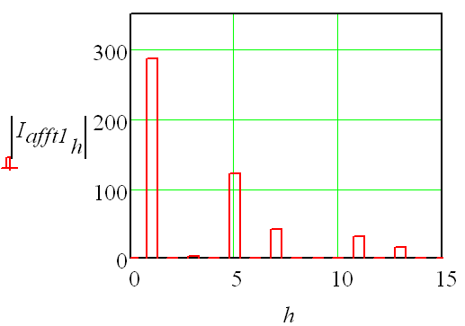
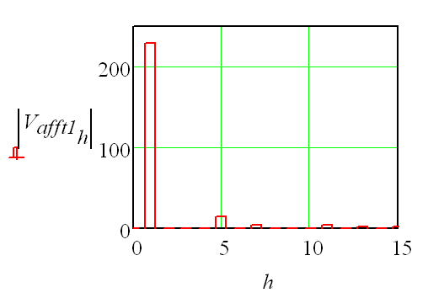
Waveform analysis: Fourier transform
The IEEE 1459 power definitions require translating time-domain waveforms to the frequency domain by means of the Fourier transform:
The level of distortion requires quantification:
ITHD_{e}= 48.3%
VTHD_{e}= 7.5%
Notes:
A first step is to isolate the frequency components and it is shown for only one phase as it is similar between phases. Application of the IEEE 1459 distortion factors is straightforward as we only need the frequency spectra of voltage and current. Voltage waveform distortion is just below the compatibility level of 8% commonly found in PQ standards and be regarded as rather high.

Slide 56
Isolating the distortion components
The non-fundamental frequency components of the effective voltage and current:
The fundamental frequency components of the effective voltage and current:
Notes:
The fundamental frequency and non-fundamental frequency components of voltage and current is found and the effect of current harmonics seen is by far greater then that of voltage harmonics by simply comparing the non-fundamental frequency values to the fundamental frequency values.

Slide 57
The three-phase effective voltage and current
The effective voltage and current :
The RMS line-neutral voltages per phase:
The RMS line currents per phase:
The RMS neutral current:
Notes:
The three-phase effective voltage and current is given and then compared to the phase rms values. The latter indicate the difference between phase values and is another motivation of why a global, in other words a single three-phase value is suggested by the IEEE 1459 to represent the “effect” of the three-phase power system.
Take note the unbalance, harmonics AND the neutral current is now represented by a single three-phase effective value.

Slide 58
The powers
Effective apparent power:
Arithmetic apparent power:
Vector apparent power:
Joint harmonic active power:
Joint (three-phase) active power:
Current distortion power:
Voltage distortion power:
Harmonic distortion power:
Notes:
The three different apparent powers are listed. The effective apparent power is the biggest number whilst the vector and arithmetic apparent power resulted in the same value.
Summation of all the harmonic powers over the 3 phases indicate a negative value, which enable the interpretation that this 387 Watt is dissipated in the impedance between the load and the PCC. The physical explanantion is that of active energy being converted from the 50 Hz components to harmonic components and then flowing in a direction opposite to the consumption of 50 Hz energy- backwards to the source- with the conclusion commonly found in practise that a non-linear load is generating harmonic active power.
Take note that the direction of harmonic active power per harmonic can be either positive or negative but that in this case the summation of all harmonic orders tells us that in total, harmonic active power is “generated” by the non-linear load.
Lastly, be careful to not believe that a method for quantifying the contribution of a distortion source to the total distortion at a PCC has been demonstrated! This is not true. In a three-phase power system with these distortion sources located all-over the power system, single-point measurements cannot be used for the latter goal. All sources of distortion requires investigation, and measurements will have to be taken synchronously, possibly as accurate as one can get by synchronising all instruments by measn of a GPS timing signal.
Lastly, power cannot flow! It is rather energy that flow.

Slide 59
And the power factors….
The arithmetic power factor: 0.465 p.u.
The vector power factor: 0.465 p.u.
The effective power factor: 0.405 p.u
And the “pollution” factors….
Harmonic pollution:
Unbalance pollution:
Unbalance factors:
Notes:
The effective power factor is the smallest number, supporting the statement that it is the most fair way to reflect the impact of harmonics and unbalance on the effectiveness by which useful (active) power is sustained by the power system under consideration.
Harmonic pollution is seen to be only 3.6% in terms of the growth in apparent power due to waveform distortion. The harmonic distortion factors were rather high, nearly 40% for current and 8% for voltage but the impact on apparent power is not that high as the energy levels ascociated to the harmonics are relatively low.
Unbalance accounts for 9.1 kVA, or, 4.4%.
The unbalance factors are rather low, but still has the ability to result in claiming nearly 5% of the apparent power that has to be sustained by the power system as the energy levels ascociated to this fundamental frequency components are high.

Slide 60
Summary
The three-phase effective power factor is numerically the smallest if unbalance and/or waveform distortion exist.
It is a helpful reflection on the impact of nonsinusoidal waveforms, unbalanced loading and asymmetrical supply voltages from the point of view from operating such power system.
It is possible to isolate the contribution of harmonics to useles power by means of voltage distortion power (D_{V}), current distortion power (D_{I}) and harmonic distortion power (D_{H}).
The three-phase effective distortion index for voltage (VTHD_{e}) and current (ITHD_{e}) furthers straightforward calculation of distortion powers.
The contribution to apparent power by both voltage asymmetry and unbalance in loading, was shown to be significant even with “low” values in V_{UB} and I_{UB}.
Notes:
To summarise this part of Module 8 on power definitons:

Slide 61
Modern Power Theory
Conclusion on Power Theory
Notes:
And, in conclusion on this module:

Slide 62
Conclusion
The classical power theory explains phenomena in a power system with a sound physical explanation but is inadequate when waveforms are non-sinusoidal, loading is unbalanced and voltage waveforms are asymmetrical.
Numerous approaches to power theory exists which are formulated in either the time- or frequency domain.
New contributions are forthcoming as inadequacies are better understood.
In general, a power theory has to:
Conform to Electrical Network Laws
Explain Physical Phenomena
Be Measurable
Enables Compensation
The IEEE 1459-2000 is a practical approach to the operation of a power system

