Slide 1


IS MEASURING PERFORMANCE IRRATIONAL OR INEFFICIENT?
Inaugural address
by
Chris van Heerden

Slide 2


How do we perceive performance?
The execution of an action.
The way in which someone or something functions.
Something accomplished: A deed or feat.
The fulfilment of a claim, promise, or request: Implementation.
The ability to perform: Efficiency
The manner of reacting to stimuli: Behaviour
To improve.
Competence.

Slide 3
Is measuring performance applicable to your life?
Knowledge
Goals, intentions, adaptation to external environment
Symbol processing
Algorithm, functional architecture
Biology
Physical, neuronal, representation of processing
Source: Moser-Mercer (2008)

Slide 4
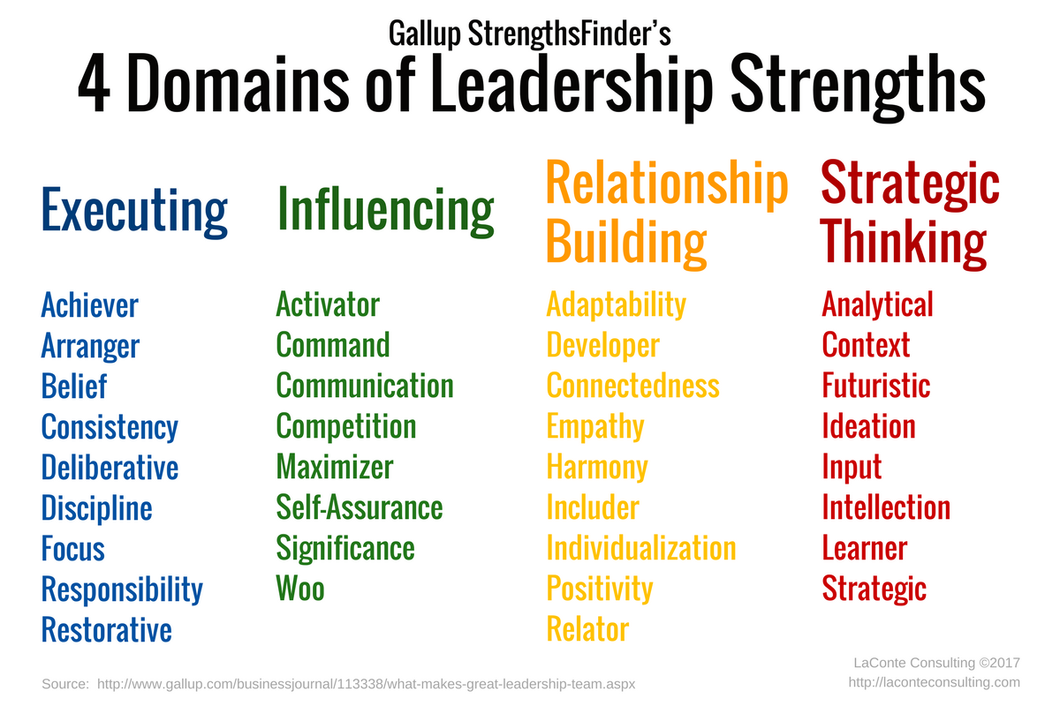
Why is measuring performance important to me?

Slide 5
Why is measuring performance important to me?
A doer, not a talker.
Make things happen.
Need to make measurable progress toward one or two goals each day to feel successful as a human being.
Instinctively, usually spend hours assessing the reasons why you failed or missed a goal.
Carefully examine why you were caught off guard by a crisis, stalled by a problem, or stymied by an obstacle.

Slide 6
Why is measuring performance important to me?
Need to gain perspective:
                Impact of their practices; and
                Influences overall performance.
                The life-course pattern altered by social and environmental structures and changes, which can produce new social structures (McDaniel & Bernard, 2011).

Slide 7
How do we perceive performance?
Irrational (Lo, 2006; Mata et al., 2006; Brehmer, 2007).
Lord Kelvin (Norton & Kaplan, 1991) stated: “I often say that when you can measure what you are speaking about, and express it in numbers, you know something about it; but when you cannot measure it, when you cannot express it in numbers, your knowledge is of a meagre and unsatisfactory kind. If you cannot measure it, you cannot improve it”.

Slide 8
How do we perceive performance?
Is it possible to truly measure the level of performance with the presence of irrational behaviour?
Why and to what extent are existing methodologies/ performance measurements tools limited due to human behaviour?

Slide 9
Measuring performance in the field of finance
Markowitz (1952; 1959).
Modern portfolio theory assumptions:
  Financial markets are efficient; and
  Investors are risk-averse and rational.
  Behavioural finance (Lo, 2004; 2006):
  Time-varying efficient; and
  Irrational behaviour & how we react to information.

Slide 10
Measuring performance in the field of finance
Cause of irrationality and market inefficiency.
Practitioners argue implementation (Warner, 2010):
Risk considered to be something perceived by individuals who are self-aware (Holton, 2004)?
Markowitz (1952:77) argued “that the investor does (or should) consider expected return a desirable thing and variance of return an undesirable thing”.

Slide 11
Measuring performance in the field of finance
“The uncertainty that an investment will earn its expected rate of return” (Brown & Reilly, 2009:1024).
Knight (1921): objective and subjective probabilities.
Keynes (1921), Ramsey (1931).
Difficult to rationally and quantitatively defend the objective interpretation of probability - difficult to perceive true risk (Ramsey, 1931; Holtoon, 2004).

Slide 12
Measuring performance in the field of finance
Variance of returns - irrational tendency to rely too heavily on the very first piece of information they learn » anchoring bias (Tversky & Kahneman, 1974).
Roy (1952) disagree – lost averse? - leading to LPM.

Slide 13
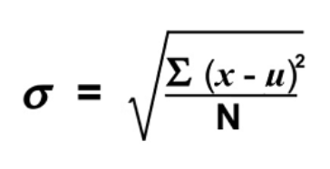
Measuring performance in the field of finance
The limitations of these risk measures (Van Heerden, 2020).
Modern portfolio theory assumes normal distributions and parameters of distributions can be correctly estimated (Van Heerden, 2020; Vaclavik & Jablonsky, 2011).
Redefine risk and amend the fundamentals of performance measurement.
-2%
Average => 3%
Actual difference => 7%
5%

Slide 14
Measuring performance in the field of finance
The Markowitz model assumes that correlation of returns is constant over time and can be correctly estimated (Markowitz, 1952; 1959).
Rest on the assumption that a linear relationship between returns exists (Vaclavik & Jablonsky, 2011).
Implication – asset valuations (CAPM) and performance measurement bias.

Slide 15
Measuring performance in the field of finance
Overcome limitations of beta – add financial ratios.
Represent a firm’s financial performance characteristics.

Slide 16
Measuring performance in the field of finance
Limitations of ratios:
Inability to explain the reasons for ‘good’ or ‘bad’ performances (Avkiran, 1997);
Inability to capture the interplay inputs and outputs (Davenport & Sherman, 1987);
Reliability on internal historical data and the sensitivity to manipulation (Van Heerden & Heymans, 2013); and
Inability to always consider the risk associated with the investment or company (Gâdoiu, 2014).

Slide 17
Measuring performance in the field of finance
Reference point/proxy/threshold?
“There is really no such thing as a truly riskless asset” (Brigham & Ehrhardt, 2005:312).
Proxy/reference point of comparison - Access to good sets of comparable entities in terms of industry, size and risk.

Slide 18
Measuring performance in the field of finance
Measuring approach limited:
  No consensus on how to measure/define risk;
  Overall company performance orientated;
  Ignoring input factors and hidden costs;
  No benchmark proxies exist; and
  No methodology offered to measure personal/employee performance.

Slide 19
Measuring performance in the field of operational research
Farrell (1957).
DEA (Charnes et al., 1978) & Stochastic Frontier (Aigner et al., 1977; Meeusen & Van den Broeck, 1977):
Selection of inputs and outputs (Berg et al., 1991).
Benchmarking (Avkiran, 1999; Jaforullah & Whiteman, 1999).

Slide 20
Measuring performance in the field of operational research
Balanced scorecard (Kaplan & Norton, 1992):
Consider objectives, measures, and targets (Niven, 2002), ignoring input-orientated efficiency.
The objective of performance evaluation and the information used depends on the perspective of the evaluator (Gardner & Mills, 1994).
Irrational » Herding effect or bandwagon effect.

Slide 21
Measuring performance in the field of operational research
Reason for irrational selection:
Cognitive bias;
Irrational exuberance; and
Lack of control.

Slide 22
Measuring performance in the field of operational research
Rosaz and Villeval (2012) argue that the quality of appraisals can be limited by biases in reviews due to behavioural or strategic reasons.
When: employees’ effort is imperfect » tendency for the performance evaluation to be biased at the company’s advantage (Gibbs, 1991; Prendergast & Topel, 1993; Prendergast, 1999; Lazear & Gibbs, 2009).

Slide 23
Measuring performance in the field of operational research
“… the needs of human reality impose cognitive limits on mankind that restrict inputs into the decision-making process, leading to seemingly irrational choices” (Parisis & Smith (2005:6).
Top management links bonuses to desired outcomes, immediate goals are overemphasised.
Implication for academia?

Slide 24
Conclusion
Irrational tendences of human behaviour led to:
Misguided development; and
Wrongful implementation.
Performance remains inherently relative, which is why no ratio or module will ever “predictably lead” to success (Rosenzweig, 2007:15).
Tempt management without considering the input costs.
Better why to motivate greater performance, to measure it, and how to link bonuses?
Performance measurement – one of our cognitive actions?

Slide 25
Thank you.

Slide 26
Vote of thanks
Colleagues;
Family;
Prof Paul Styger;
Prof André Heymans;
Prof Wilma Viviers;
Past and current Deans and School Directors;
Sabrina
Esmé, Chanté, Jana, Ilza and Crista Galli;
Wilmé; and
Our Father.

Slide 27
Thank you.

