Slide 1
Teacher Training
Day 1
Notes:
Stanovich (1986, p. 362) defined phonological awareness as: “conscious access to the phoneme level of speech stream and some ability to cognitively manipulate representations at this level”.

Slide 2
Literacy development
Why are we here?
Historical trends in beginning reading.
Language and reading development.
Notes:
The risk for learners, of being a failure at reading is determined by the
knowledge and skills of their teachers.

Slide 3
Why are we here?
Phonological awareness skills:
Support the acquisition of reading skills.
Important indicators of early reading skills.
Important in the development of reading skills
Notes:
Phonological awareness skills support the acquisition of reading skills
Phonological awareness skills are considered as the most important indicators of early reading skills
Literature suggests a strong positive correlation between phonological awareness skills and the development of reading skills
Children who don’t have phonological awareness skills have difficulty in reading
Pre-school phonological awareness instruction impact positively on grade one reading outcomes

Slide 4
Historical trends in beginning reading:
1950-1965: The era of conditioned learning
1966-1975: The era of natural learning
1976-1985: The era of information processing
1986-1995: The era of socio-cultural learning
1995-present: The era of engaged learning
Notes:
The importance of the history of beginning reading lies in the fact that an overview of the past provides us with an understanding of the study and practice of beginning reading.
Motivation to learn to read: DAP Activities – how to tell a story
CaP:They distinguish between the front and back of a book.
They know that pictures and words differ.
They can indicate that the direction of reading is from left to right and from top to the bottom.
They follow with their finger to indicate reading direction.
Can identify the beginning and end of a story, page, line, sentence or word.
Can indicate that a picture is upside down.
Realizes when the teacher reads words in a sentence in the wrong sequence.

Slide 5
Language and reading development:
Emergent literacy
Concepts about print
Basic facts about reading
Knowledge of language
  4.1 Word-level instructional strategies
  4.2 Text-level comprehension strategies
Notes:
A substantial amount of literacy learning takes place before children begin grade 1
These form the basis for their later reading success
Children with a broad language and literacy experience are better equipped to succeed in reading
Main accomplishments: oral language skills and phonological awareness; motivation to learn and appreciation of literate forms; print awareness and letter knowledge.

Slide 6
1. Emergent literacy:
Involves the building of concepts about print.
Grade R teachers and parents models the processes of reading and writing.
Emergent literacy follows a predictable course.
Notes:
At first, students realise that print carries meaning, but they are not aware that letters represent the sounds in words.
Next, they use their knowledge of letters as well as their awareness of speech sounds to attempt spelling and reading by sounding out parts of words.
Skill at sounding out words unfolds gradually as the child becomes aware of all the speech sounds and how letters can be matched to the sounds.
With appropriate instruction, children learn quickly how print patterns represent speech.

Slide 7
2. Concepts about print:
They distinguish between the front and back of a book.
They know that pictures and words differ.
They can indicate that the direction of reading.
They follow with their finger to indicate reading direction.
Can identify the beginning and end of a story.
Can indicate that a book is upside down.
Realizes when the teacher reads words in a sentence in the wrong sequence.
Notes:
Children who grow up with rich text experiences often develop print concepts without, explicit instruction, but children who grow up in a text-poor environment may require explicit instruction

Slide 8
3. Basic facts about reading:
Learning to read is not a natural process or easy for most children.
Before children can easily sound out or decode words - they must have awareness of the speech sounds.
Notes:
5% of all learners learn to read with ease
20%-30% learns to read easily with explicit instruction.
60% of learners find it difficult to learn to read
15%-25% learners finds learning to read the most difficult thing
5% will be identified as reading disabled.
For 75%-80% of learners teaching reading do make a difference.

Slide 9
4. Knowledge of language
5 Components of reading:
Phonological awareness
Phonics
Fluency
Vocabulary
Comprehension
Notes:
Instruction in phonological awareness requires the teacher to differentiate syllables and to count, produce, blend, segment, and manipulate the individual speech sounds in words.
Phonics instruction requires the teacher to teach children spelling correspondences at sound, syllable, and morpheme level.
Teaching fluency requires the instruction of automatic, accurate word recognition, which rests in part on the ability to process syllables and morphemes found in longer words.
Instruction of vocabulary requires an understanding of semantic organization, word structure, grammatical rule and meaning.
Comprehension instruction requires the teacher to know about text organization, genre and academic discoursTo integrate these components an informed teacher also understands that they are interdependent; for example, vocabulary learning is facilitated by phonological ability

Slide 10
4.1 Word-level instructional strategies:
Phonological awareness
Phoneme awareness
Phonics instruction
Syntax and semantics (sentences)
Notes:
Phonological awareness
When young children are involved with various phonological awareness tasks, they come to realise that one can actually ‘play’ with language. Phonological awareness need to be taught in a specific sequence.
Phoneme awareness
Phonemic awareness is the ability to hear, identify and manipulate individual sounds – phonemes – in spoken words.
Phonemic awareness instruction is most effective when
alphabetic letters is included;
there are fewer rather than more manipulations of phonemic units and;
instruction is conducted in small groups.
Phonics instruction
Phonics instruction helps children to learn the relationships between the letters of written language and the sounds of spoken language. Effective phonics programmes are systemic and explicit and have ample opportunities for children to apply what they are learning about letters and sounds to the reading of words, sentences and stories.
Syntax and semantics (sentences)
Knowledge of sentences enhances language comprehension. Activities to enhance syntactic awareness are: Repetition of phrases; Describe a picture; Build a story; Listen to words in sentences; Substitute words in sentences; Build a sentence.

Slide 11
4.2 Text level instructional strategies:
Vocabulary development
Fluency
Comprehension
Notes:
Vocabulary development
Beginning readers use their oral vocabulary to make sense of print
Text comprehension is linked to vocabulary development
Vocabulary can be developed:
indirectly when students listen to adults read to them and
directly when students are explicitly taught both individual words and word learning strategies
Fluency
Fluency enables students to understand what they read
Reading fluency can be developed by modelling fluent reading
Comprehension
The purpose of reading is to comprehend and interpret the text
model text comprehension strategies by setting a purpose for reading
thinking aloud while reading the text
Failure to develop an adequate vocabulary, understanding of print concepts or phonological awareness during the preschool years constitutes some risk for reading disabilities

Slide 12
Teaching activities and materials:
Rich literature-based environment
Working in groups
Play-based instruction
Notes:
I would like to use an analogy to explain the interdependence of phonological awareness and a balanced literacy programme in grade R. To bake a cake, one needs a lot of ingredients, for example, flour, eggs, baking powder, sugar, oil and salt. Phonological awareness is like the baking powder in the cake; without baking powder success is impossible, but with baking powder alone it is impossible to produce a cake. Rich literature-based environment
Effective literacy instruction occurs when teachers engage learners with instructional materials and other texts inside a rich, literature-based environment (well-stocked in-class libraries and ample opportunities to read and write).
Working in groups
A balance should also be maintained regarding working with the whole class, small groups and individuals
Phonemic awareness instruction is most effective in small groups. Working with individuals or in small groups increases the intensity of instruction and benefits high-risk learners.
Play-based instruction
Play activities is appropriate for instruction in kindergarten. These activities include singing songs, acting out stories and situations.
Phonemic awareness is critical but meaningless unless it is part of a more comprehensive literacy programme
Instruction should be deliberate and purposeful and child appropriate.

Slide 13
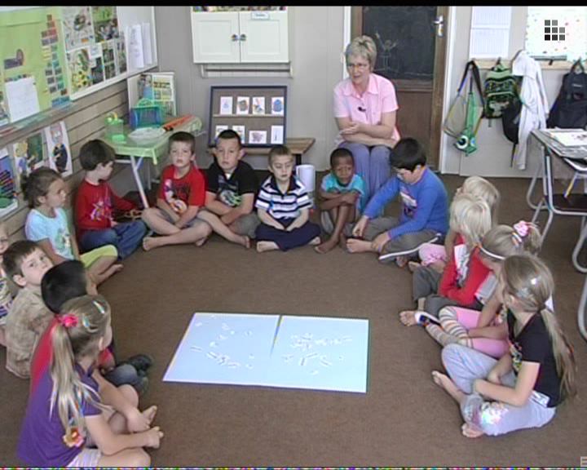

Slide 14
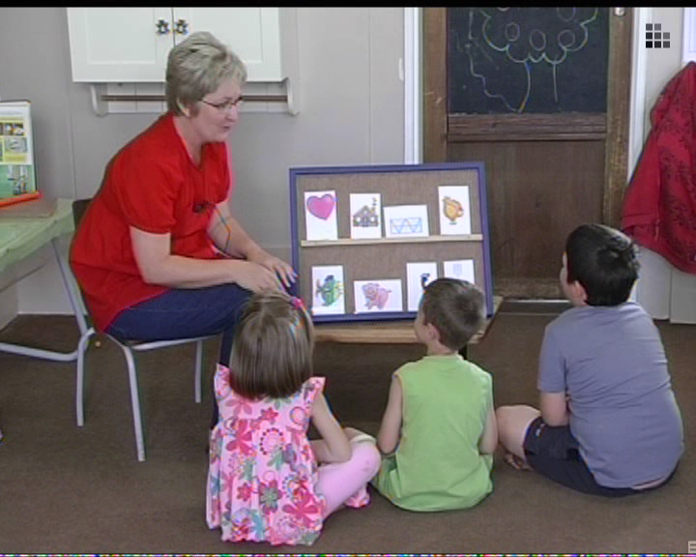

Slide 15
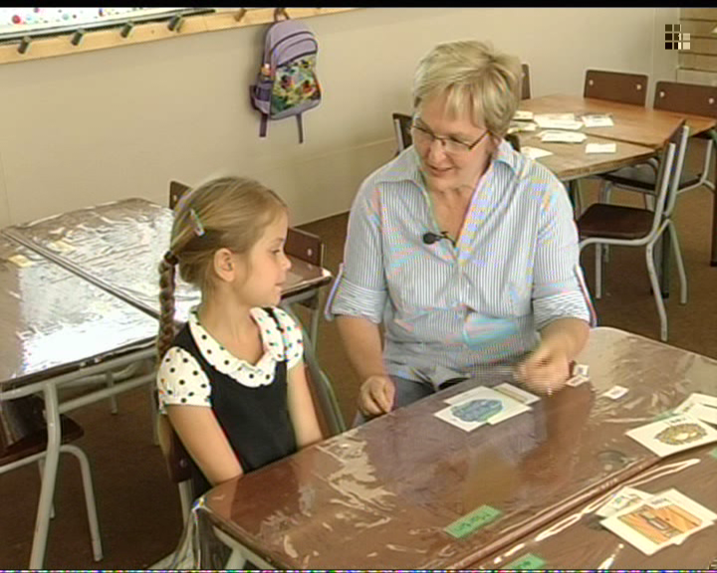

Slide 16
Phonological Awareness
Young children perceive spoken words as wholes.
Phonological awareness skills include the ability to rhyme words and to break words into syllables.
Notes:
This will be discussed in detail tomorrow.
When a child become aware that spoken words are made up of sounds, phonological awareness has developed.
Children who are delayed in the development of phonemic awareness have a very difficult time making sense out of “phonics” instruction, and they certainly have little chance to notice the phonemic patterns in written words on their own. A simple way to say this is that for individual children, phonemic awareness is what makes phonics instruction meaningful. If a child has little awareness that even simple words like cat and car are composed of small “chunks” that are combined in different ways to make words, our alphabetic way of writing makes no sense. (Torgesen and Mathes p.13)

Slide 17
Is phonological awareness the same as phonemic awareness and phonics ?
Phonological awareness relates to speech sounds. It involves identifying and manipulating larger parts of spoken language.
Phonemic awareness is a subset of phonological awareness, it is when you heard a word and can divide it into the smallest parts.
Phonics requires students to match letters with sounds. It involves the understanding that there is a predictable relationship between phonemes and graphemes, the letters that represent those sounds in written language.
Notes:
Teachers tend to confound phonological awareness, phonemic awareness, and phonics. A clear distinction is necessary, because knowledge about rhyme and syllables (phonological awareness) are a pre-requisite for teaching phoneme awareness, while instruction in phonics encloses the correspondence between the sounds and the symbols, for example /a/ for apple. The distinction is further important, because phonological and phonemic awareness are excellent activities for grade R and provides a good foundation for later work in sound-symbol correspondence: phonics.
Phonological awareness relates only to speech sounds, not to the alphabet letters or sound-spellings. It involves identifying and manipulating larger parts of spoken language. Typical tasks would require children to analyze, make judgements about or manipulate sounds in spoken words – only spoken stimuli are needed.
Phonemic awareness is a subset of phonological awareness, it is when you heard a word and can divide it into the smallest parts.
Phonics requires students to match letters or letter patterns with sounds (decoding) and to use this information to read words. Phonics is the understanding that there is a predictable relationship between phonemes and graphemes, the letters that represent those sounds in written language. The goal of phonics instruction is to help children learn and use the alphabetic principle: the understanding that there are systematic and predictable relationships between written letters and spoken sounds.

Slide 18
Sequence of teaching phonological awareness
Start with less complex tasks and progress to more complex tasks:
Words into syllables |  | Rhyme |  | Initial and final sounds |  | Segmentation and blending |  | Phoneme Manipulation
Notes:
Handout: Table 2.2 Instructional sequence of phonological awareness, with progression

Slide 19
Support documents:
NCS
Foundations for learning: Government gazette 30880
Laying solid foundations for learning, Grade R kit
Foundations for learning:
  Assessment framework grade R
  Milestones.

Slide 20
Three levels of planning:
Learning programme
Work schedule
  – Planning for two weeks
Lesson plans

Slide 21
What have we learned today?
The importance of phonological awareness
Language and reading development
Teaching activities and materials
Planning of teaching activities
Notes:
Allow for questions and comments

